Slide 1

Developing the Postulates of Special Relativity in Group Discussions
#NSTA17
(Distribution copy with images removed)
Last updated: 4/1/2017
Dr. Igor Woiciechowski Associate Professor of Mathematics Alderson-Broaddus University
Rosa Villastrigo
Program Manager
Johns Hopkins University
Center for Talented Youth
Dr. Muhammad Ali Yousuf*
Assistant Program Manager
Johns Hopkins University
Center for Talented Youth
mali@jhu.edu

Slide 2
What we are going to discuss
Some basic definitions needed
The course at CTY
Review of Galilean Relativity
Concept of ‘Aether’
Michelson-Morley Experiment
Einstein’s Solution
Questions to start class discussion
Selected videos, etc.

Slide 3
Some names and definitions before we start

Slide 4
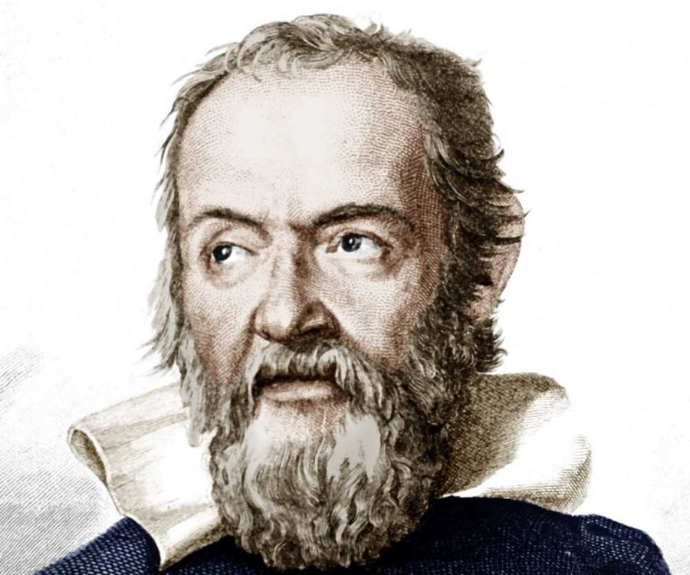
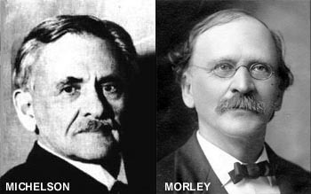
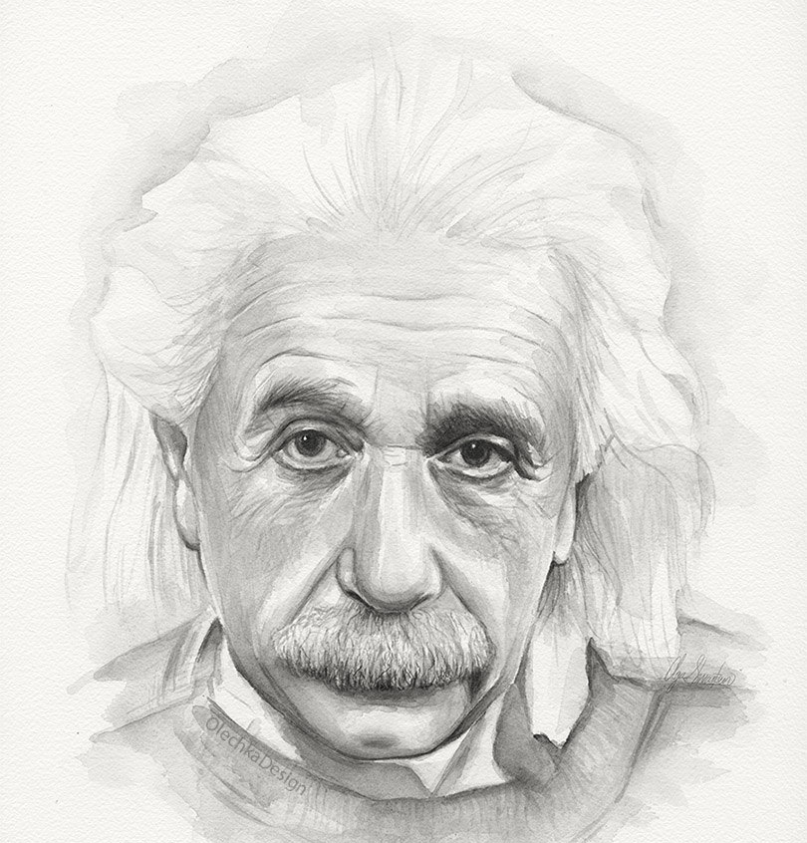
Four people you need to know: Galileo, Michelson, Morley & Einstein
Garfield Image
Removed
… and of course, Garfield!

Slide 5
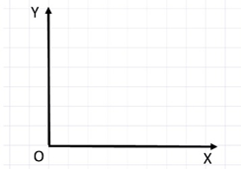
Frames of Reference
A Frames of Reference is a system of geometric axes in relation to which measurements can be made. For example, in two dimensions:

Slide 6
Inertial Frames
Inertial frames are systems moving at constant speed. Which means if you measure acceleration ‘inside’ that system, it will be zero. A car moving with constant speed on a straight road is a good approximation.

Slide 7

Y
A reference frame fixed in a car but moving
at constant speed v with respect to the garage
O
X
Y’
A reference frame fixed in the garage
Z
(Z is going out of the plane)
O
X’
Z’
After a few seconds, car has moved forward

Slide 8
The Course at CTY
At Johns Hopkins CTY we have learned that some of the ideas of the theory can be brought to any physics classroom where students are well-motivated and willing to do some thinking of their own.
Course Prerequisite:
Algebra II,
trigonometry and
either CTY’s Fast-Paced High School Physics or at least a “B” in conceptual physics or high school physics.

Slide 9
Review of Galilean Relativity
One of the ways is to start with the key concept of the classical mechanics, Galilean Relativity Principle.
It states that laws of mechanics are the same in all frames of reference moving with constant velocities relative to each other.
Garfield
Image
Removed
… you never told me what constant velocity means?

Slide 10
Review of Galilean Relativity
The Galilean Relativity Principle became the foundation for the Three Laws of Mechanics formulated by Isaac Newton.
Ya, I know. Like an object at rest likes to remain at rest, blah blah…
Garfield
Image
Removed

Slide 11
Review of Galilean Relativity
An important consequence of the Galilean relativity is the law of velocity addition.
A (stationary man on earth), B (moving aircraft),
C (something moving towards the cockpit in the aircraft), the velocity vector u of C relative to A is the sum of the velocity u’ of C relative to B plus the velocity v of B relative to A:
u=v+u’
Image removed

Slide 12

Review of Galilean Relativity
It leads to the famous problem of crossing a river and traveling downstream and back with the flow of water.
Students soon conclude that the traveling time is different for the two paths which are equal in length.
Let’s see how …
Hmm….

Slide 13

A boat is travelling downstream at 5 km/h relative to the shore. If there is a current of 7 km/h which direction the boat is moving with respect to water? What is the boat’s speed relative to Garfield?

Slide 14
A boat travelling upstream at 5 km/h relative to the shore. If there is a current of 7 km/h which direction the boat is moving with respect to water? What is the boat’s speed relative to the water?

Slide 15
What will happen now?
Ask your teacher, I am not in a mood today
Garfield
Image
Removed

Slide 16
Round trip in stationary water (like a lake)

Slide 17
Round trip in a river flowing towards right. What will happen now?

Slide 18
Question
Then which boat moved more distance?
Which will return late to the shore?
Garfield
Image
Removed
Why is everything moving here … leave me alone

Slide 19
And now comes Aether
According to ancient and medieval science, aether, also spelled æther or ether, is the material that fills the region of the universe above the terrestrial sphere.
The concept of aether was used in several theories to explain some natural phenomena, such as the traveling of light and gravity.
Who said it fills everything?

Slide 20
Michelson-Morley Experiment
The Michelson–Morley experiment (first performed in 1887) was designed to test this conclusion for light that presumably propagating in the flow of ether, hypothetical medium filling the entire Universe.

Slide 21
Stationary Interferometer
See the animation here http://www.brainflux.org/Physics/Special_Relativity/Michelson_Morley/

Slide 22
Interferometer Moving Through the Aether
Garfield
Image
Removed
You see,
that’s why
I don’t move
See the animation here http://www.brainflux.org/Physics/Special_Relativity/Michelson_Morley/
http://www.brainflux.org/Physics/Special_Relativity/Michelson_Morley/

Slide 23
See wave interference here:
http://sdsu-physics.org/physics180/physics180B/Topics/light/phys180Bch24.html

Slide 24
Michelson-Morley Experiment
Ultimately, the experiment indicates that there is no time difference for the returning light pulses traveling in the perpendicular directions.

Slide 25
Einstein’s Solution
Einstein suggested the following two axioms explaining the negative experimental result:
1) a uniform motion through ether is undetectable,
2) the light speed does not depend on the speed of the light source.
Garfield
Image
Removed
Le’me take notes…

Slide 26
The Two Postulates
On June 30, 1905 Einstein formulated the two postulates of special relativity:
The Principle of Relativity: The laws of physics are the same in all inertial frames of reference.
The Constancy of Speed of Light in Vacuum: The speed of light in vacuum has the same value c in all inertial frames of reference.
Garfield
Image
Removed
So I’m relatively sleeping
and relatively awake. Right?

Slide 27
Einstein’s Solution
Note that the speed of light in vacuum
c = 186000 miles per second
is so enormous that we do not notice a delay between the transmission and reception of electromagnetic waves under normal circumstances.
Garfield
Image
Removed
Can’t u make it slower …
I am trrrying to catch up …

Slide 28
Questions to start the discussion:
Garfield
Image
Removed
Start lesson from the question “How do you know you are moving or are at rest?” You can give several examples:
You are in a car moving at constant speed,
you are in a car stopped at the traffic signal,
you are sitting in the cabin of an airplane which is cruising, etc.
Convince students that there is no way to tell without looking out of the window, or identifying a frame of reference. This is what the Principle of Relativity says.

Slide 29
Questions to start the discussion:
As shown below, a car is first at rest with respect to a house and their coordinates systems are identical.
If the car now starts moving with constant speed (hence is an inertial frame) with respect to the house, which quantities must be the same in the two inertial frames of reference (house and car)? Which of the quantities may not be the same?
Speed of an object
Electric charge of an electron
Kinetic energy of a particle
Time interval between two events
Order of the elements in the Periodic Table
Garfield
Image
Removed

Slide 30
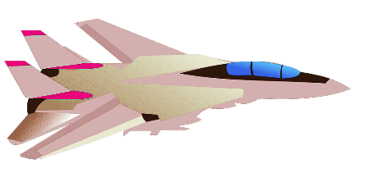
More questions …
A jet plane travelling horizontally at 1200 km/h relative to the ground fires a rocket forwards at 1100 km/h relative to itself. What is the speed of the rocket relative to the ground?
Add a slide with laser

Slide 31
More questions …
Garfield
Image
Removed
A number of follow up questions can now be asked to prepare for the next class
What does the Galilean Relativity Principle state?
How can you formulate the Rule of Addition of Velocities? (You can’t – not so easily!). The Gallilean one in intuitive:

Slide 32
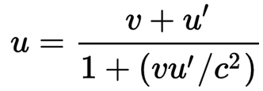
More questions …
Galilean Relativity: In general for three objects A (stationary), B (moving), C (something falling on the moving object) the velocity vector u of C relative to A is the sum of the velocity u’ of C relative to B plus the velocity v of B relative to A:
u=v+u’
Special Relativity:

Slide 33
Fun Facts (Student Research Projects)
Garfield
Image
Removed

Slide 34
GPS Navigation
Do you know that in order for your car’s GPS navigation to function as accurately as it does, satellites have to take relativistic effects into account?
Project: Ask students to explore this and find why Einstein’s theories play a role here. In particular:
How does the satellite locate your GPS? Is one satellite enough?
If not, what is the minimum number of satellite to locate your longitude and latitude?
Which department in USA controls this communication?
Are these satellites military or civilian?
… (Send an email to me at mali@jhu.edu to get the full project description)

Slide 35
Your old TV
Just a few years ago most televisions and monitors had cathode ray tube screens. A cathode ray tube works by firing electrons at a phosphor surface with a big magnet.
Each electron makes a lighted pixel when it hits the back of the screen. The electrons fired out to make the picture move at up to 30 percent the speed of light.
Relativistic effects are noticeable, and when manufacturers shaped the magnets, they had to take those effects into account.
… (Send an email to me at mali@jhu.edu to get the full project description)
http://www.livescience.com/58245-theory-of-relativity-in-real-life.html

Slide 36
Golds has a yellow color
Why so? What is the role of Einstein here?
The project combines Chemistry, Physics and Art!
… (Send an email to me at mali@jhu.edu to get the full project description)
http://www.livescience.com/58245-theory-of-relativity-in-real-life.html

Slide 37
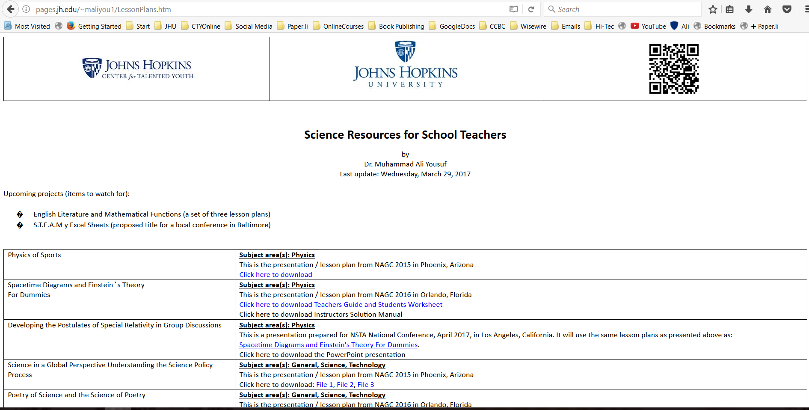
You can download all the material from
http://pages.jh.edu/~maliyou1/LessonPlans.htm
Or by scanning the QR Code below:

Slide 38
References
Garfield
Image
Removed
Albert Einstein's Theory of Relativity, https://www.youtube.com/watch?annotation_id=annotation_1846550411&feature=iv&src_vid=qhVgIW4_-AQ&v=ev9zrt__lec
Einstein's Relativistic Train in a Tunnel Paradox: Special Relativity, https://www.youtube.com/watch?v=Xrqj88zQZJg
Twin Paradox in General Relativity, https://www.youtube.com/watch?annotation_id=annotation_3823805945&feature=iv&src_vid=Xrqj88zQZJg&v=bjHLboK2M1g
At the speed of light, what would you see?, https://www.youtube.com/watch?annotation_id=annotation_850087149&feature=iv&src_vid=bjHLboK2M1g&v=BoUc4-q4Ibc
Trying to go faster than the speed of light, https://www.youtube.com/watch?annotation_id=annotation_3593779865&feature=iv&src_vid=BoUc4-q4Ibc&v=qhVgIW4_-AQ
http://www.animatedimages.org/cat-garfield-1214.htm

